Slide 1
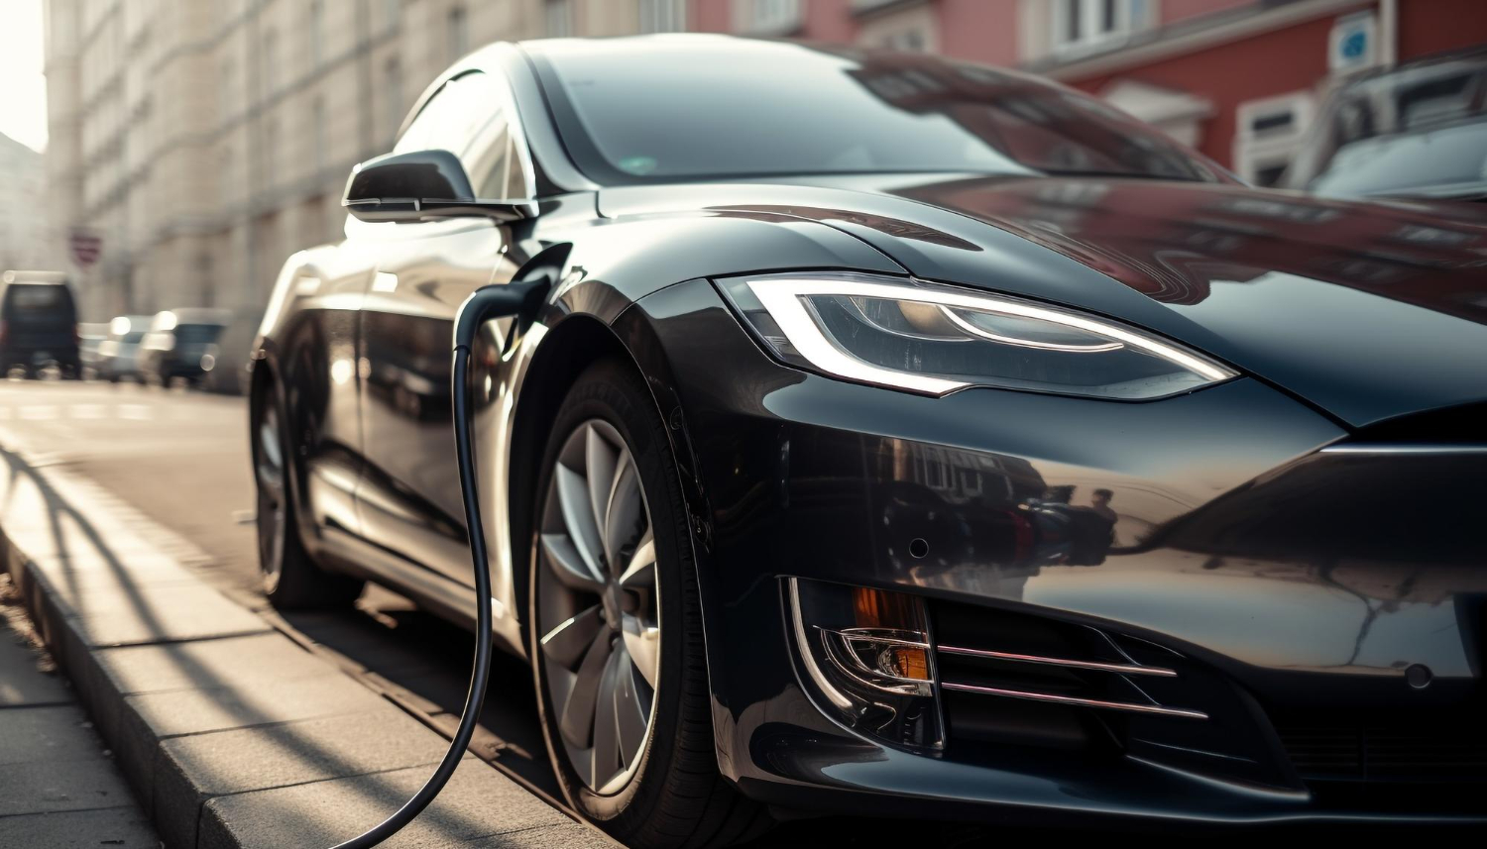
Bright Motors |
Car sale Analysis
Bright Motors has recently appointed a new Head of Sales, whose mission is to expand the dealership network, improve sales performance, and optimize inventory.
Contact us:

Slide 2
Contents
2
Revenue Trends
Steady upward trend in total revenue
Make and Model
Ford leads with over $2 billion
State Sales
Florida emerges as the leading state with 15.14%
Rating Scales
Provides quick insight into customer ratings
Total Revenue and Cars Sold
Revenue showed strong growth between 2010 and 2015
Suggestions
Use strong financial periods to build a more diverse and resilient
Thanks
Questions and Answers
Notes:
slidesppt.net

Slide 3
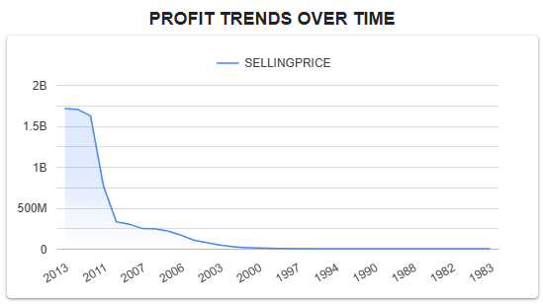
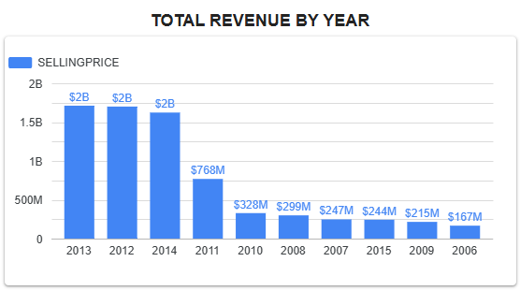
Revenue and Trends Over Time
3
This bar chart highlights a steady upward trend in total revenue, reflecting sustained performance and growing market confidence. The standout years achieved annual revenues exceeding $2 billion, marking key milestones in the company’s financial success.
The graph above illustrates the profit trend achieved over the years. A clear upward trajectory is visible, signaling consistent growth and a positive outlook for the market
Notes:
slidesppt.net

Slide 4
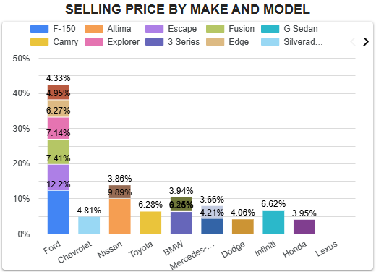
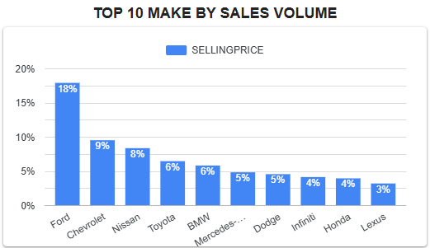
Make And Model by Sale Volume
4
The top 10 vehicle makes that have contributed the most total revenue over time include global giants like Ford, Chevrolet, and Nissan, each generating hundreds of Millions annually. Ford leads with over $2 billion in recent revenue.
This stacked vertical bar chart illustrates the top-performing vehicle brand in terms of revenue generation over the years. Its financial success is largely attributed to a broader range of models, which contributed to higher cumulative sales compared to competing brands. Contributing 42.3% of total revenue
Notes:
slidesppt.net

Slide 5
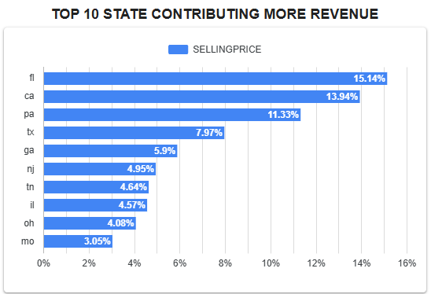
State by Sale Volume
5
Florida emerges as the leading state in total revenue contribution, accounting for 15.14% over the analyzed period. The chart underscores regional performance trends and Florida’s consistent economic strength.
Notes:
slidesppt.net

Slide 6
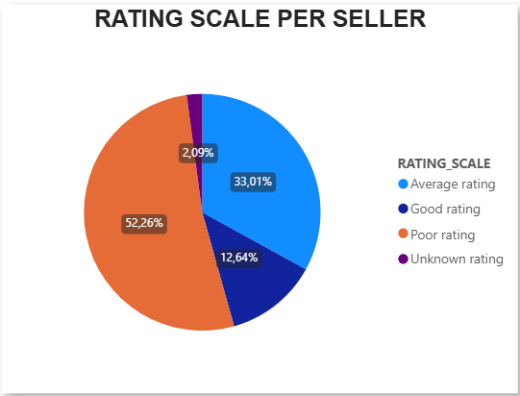
Rating scale for Sellers combined
6
Seller ratings are visualized in this pie chart, highlighting how performance is distributed across the rating scale. The chart provides quick insight into which sellers consistently meet expectations and where support or intervention may be needed.
Notes:
slidesppt.net

Slide 7


Total Revenue and Cars Sold
7
Revenue showed strong growth between 2010 and 2015, contributing $6.4 billion to the total.
The forecast covers the number of cars sold between 1982 and 2015. During the period of 2010 to 2014, the market saw a significant rise in demand, with Ford leading the pack by capturing 19% of sales
Notes:
slidesppt.net

Slide 8
Suggestions
8
Consumer Trends
Targeted Incentives
Competitive Benchmarking
Enhance Brand Loyalty
The 2010-2015 period post-recession was about value and reliability. The next cycle might be defined by electric vehicles (EVs), connectivity, and sustainability
Develop flexible sales and finance programs that can be quickly activated when early signs of market-wide demand appear
Don't just focus on your own success. Analyze how competitors have adapted since 2015. They will have learned from Ford's leadership and will be competing more aggressively in the next growth cycle
A customer who bought a Ford during the 2010-2014 boom should be a customer for life. Implement superior post-purchase programs, owner loyalty rewards, and service experiences to ensure they return for their next vehicle, regardless of the economic cycle.
Notes:
slidesppt.net

Slide 9
THANK
YOU

